Slide 1


Insurance Fraud
The Hidden Cost Burdening Us All
A comprehensive look at how insurance fraud undermines trust, increases costs, and affects every citizen..
Notes:
1

Slide 2
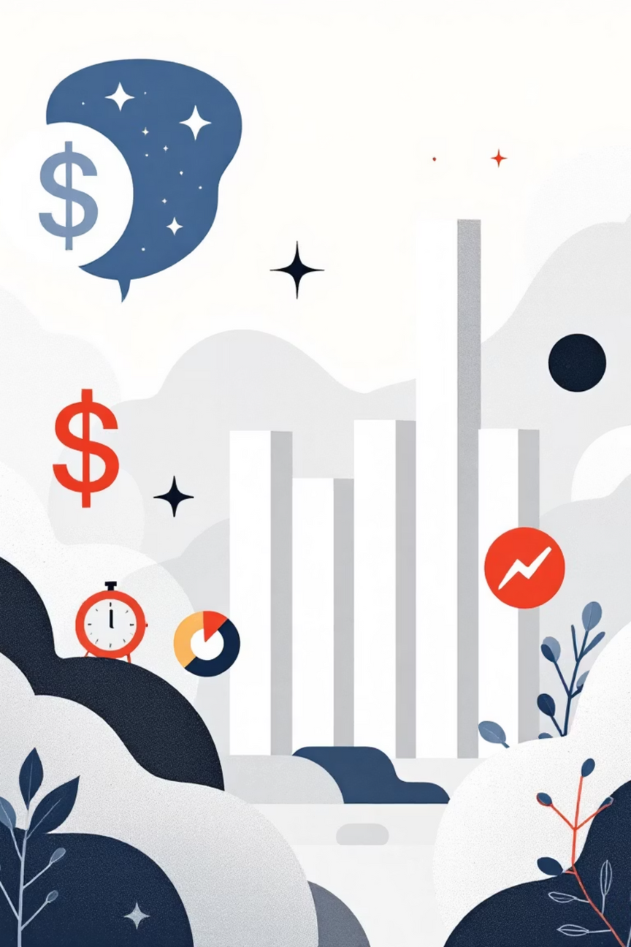
The Shocking Scale of Insurance Fraud
$308B
$950
$30B
Annual Cost
Per Family
Workers' Comp
Total insurance fraud losses in the U.S. per year
Average hidden tax added to American household premiums annually
Dedicated fraud losses in workers' compensation claims
$29B
Auto Insurance
Amount lost specifically to auto insurance fraud schemes
Source: Coalition Against Insurance Fraud, 2024
Notes:
2

Slide 3
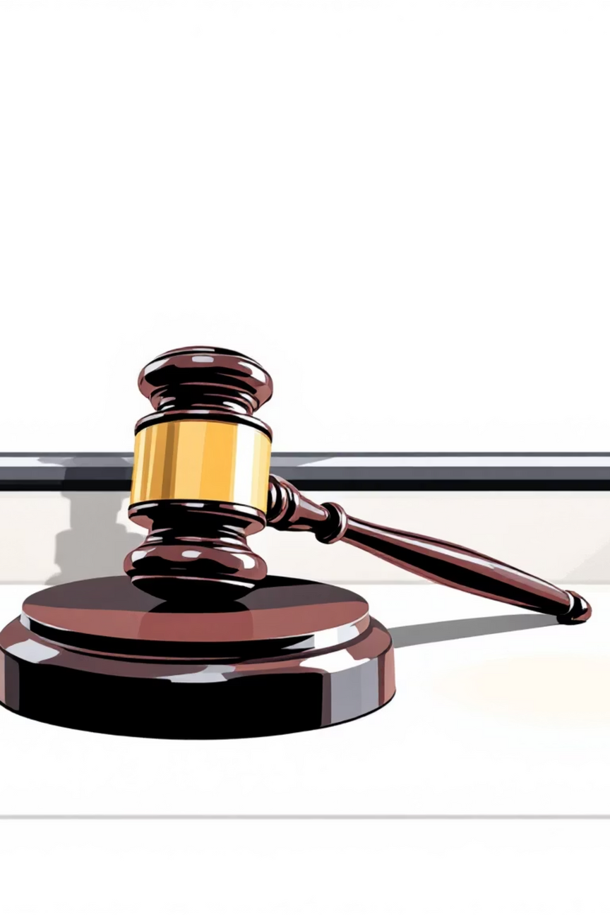
What Is Insurance Fraud?
Defining the Crime
Insurance fraud is deliberate deception against or by insurance companies for unlawful financial gain. It encompasses false claims, inflated damages, fabricated policies, and premium evasion schemes designed to extract money dishonestly.
False Statements
Intent to Deceive
Knowingly providing inaccurate information on claims or applications
Deliberate action with clear purpose to mislead insurers
Criminal Impact
Direct effect on claims processing or policy eligibility decisions
Notes:
3

Slide 4




Types of Insurance Fraud
Insurance fraud takes many sophisticated forms, each targeting different vulnerabilities in the system:
Claim Fraud
Premium Fraud
Exaggerating or fabricating losses, including staged accidents and false damage reports
Deliberately understating risk factors to qualify for artificially lower premiums
Third-Party Fraud
Insider Fraud
Healthcare or service providers billing for unnecessary or completely fabricated services
Agents or employees colluding with customers to defraud insurers (American Academy of Actuaries, 2024)
Notes:
4

Slide 5


Real-World Examples: Fraud Schemes Uncovered
Automotive Fraud
Healthcare Fraud
"Salvage fraud" involves flooding-damaged vehicles undergoing "title washing"—fraudsters remove damage history from records, repaint vehicles, and resell them as accident-free, deceiving unsuspecting buyers.
Billing insurance for medical procedures never performed, inflating legitimate treatment costs, or submitting duplicate claims. One scheme involved billing for thousands of unnecessary surgeries.
Agent Fraud: Insurance agents pocketing premium payments while issuing counterfeit policies, leaving customers uninsured and perpetrators vanishing with millions (Nebraska Dept. of Insurance, 2022).
Notes:
5

Slide 6

Legal Frameworks and Enforcement
A multi-layered legal system protects insurance integrity through state and federal statutes with serious consequences:
State Laws
1
Nearly all states criminalize insurance fraud with specific statutes (e.g., Nebraska Rev. Stat. §§44-6601 to 44-6608)
2
Federal Oversight
18 U.S. Code §1033 targets interstate fraud and false statements by insurance officers
Penalties
3
Fines up to $50,000 or double the fraud amount, plus imprisonment of 1-5 years (California Penal Code, 2025)
Notes:
6

Slide 7




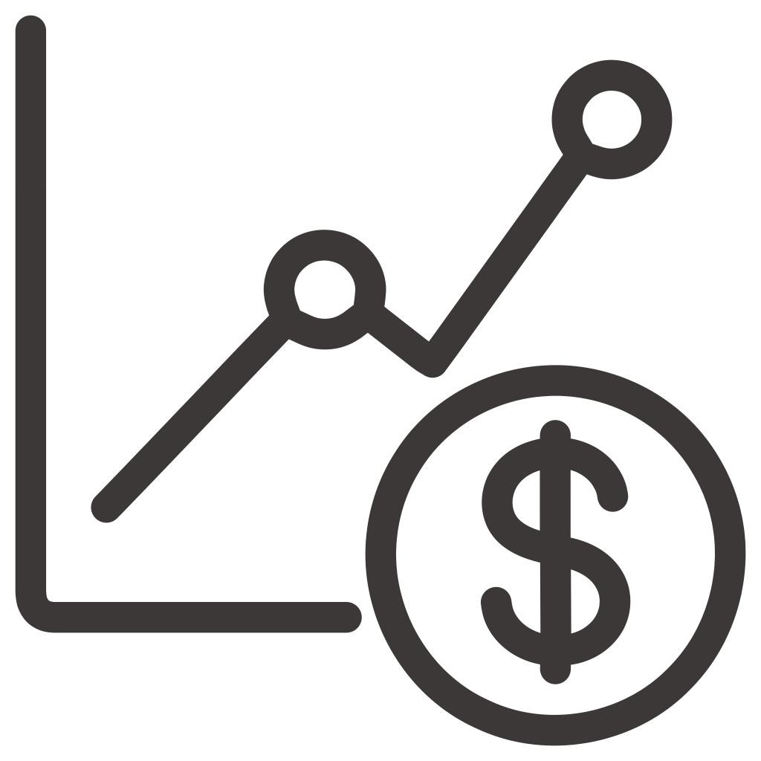



The Human and Economic Impact
Insurance fraud extends far beyond numbers—it harms real people and destabilizes communities:
Vulnerable Populations
Rising Premiums
Language, cultural, and economic barriers leave disadvantaged communities disproportionately affected
Fraud inflates costs, making insurance less affordable and accessible to families
Economic Strain
Legitimate Claims
Small businesses and individuals bear the burden through higher costs and limited coverage
Resources diverted from honest policyholders, delaying their claims and recovery
Notes:
7

Slide 8


Fighting Back: Prevention and Detection
Advanced technology, specialized units, and public engagement form the frontline defense against fraud:
Public Awareness
Data Analytics
Mandatory antifraud plans and education campaigns empower consumers to recognize schemes
Specialized Units
Predictive modeling and cross-agency collaboration identify suspicious patterns before payouts
Dedicated Insurance Fraud Prevention Divisions and Special Investigation Units (e.g., Nebraska's IFPD)
Notes:
8

Slide 9

Challenges in Combating Insurance Fraud
Sophistication & Crime
Jurisdictional Gaps
Organized crime networks employ elaborate schemes that evolve faster than detection methods, utilizing technology to mask origins and coordinating across regions
Interstate fraud and "title washing" create enforcement blind spots where state agencies lack authority to pursue perpetrators across borders
Balancing Act
Aggressive fraud detection risks wrongfully denying legitimate claims, requiring careful calibration to protect honest policyholders
Notes:
9

Slide 10

Why We Must All Stay Vigilant
Awareness
Strong Laws
Advanced Tools
Consumers, insurers, and regulators must recognize fraud's pervasive threat
Enforcement and penalties deter fraud at every level
Technology and collaboration reduce fraud successfully
Insurance fraud is costly, pervasive, and affects everyone. Together—consumers, insurers, regulators, and law enforcement—we can protect the integrity of insurance systems and keep premiums affordable for honest families and businesses.
Notes:
10

Slide 11
Thank You

